Slide 1

SOFTWARE ENGINEERING
INTRODUCTION OF DEPARTMENT

Slide 2





History
Establishment
First Bachelor Student Admission Period
First Master Student Admission Period
2019-2020 Academic Year
2021-2022 Academic Year
2018

Slide 3

Goals of the Department
As the Software Engineering Department of Samsun University Faculty of Engineering, we are able to lead in the changing world and technology conditions required by the software industry, to contribute to developments in technology, to have the knowledge required by the era in the academic field and all sectors of the software industry, to be a researcher, questioner, analyzer, and able to work in a team. We aim to train expert personnel who are qualified to identify current problems in this industry.
Our curriculum, which we have created to achieve the goals of our department, covers the topics addressed and determined by the current international standards organizations ISO and IEEE.

Slide 4

Job Opportunities for Department Graduates
Department graduates,
They can work in many fields such as banking, telecommunications, automotive, hospitals, robotics, automation and software companies, defense industry, web design and programming, universities and Teknopark.

Slide 5

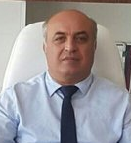
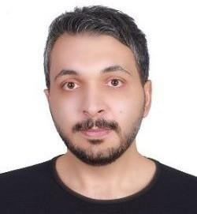
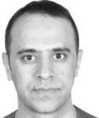
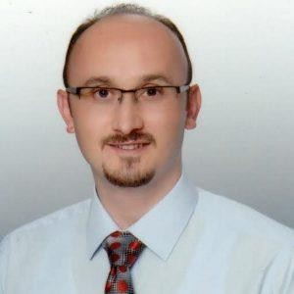
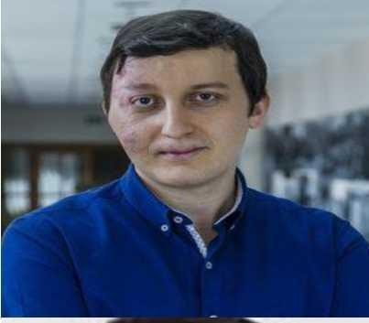
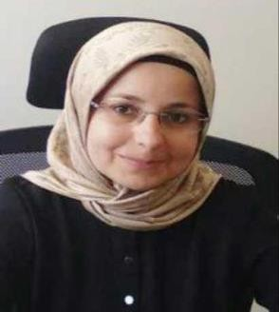
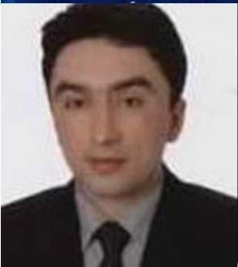
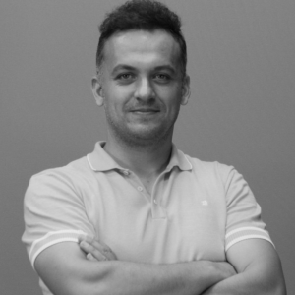
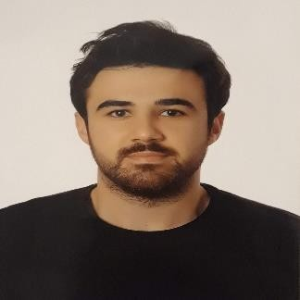
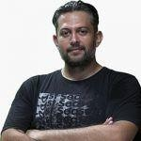
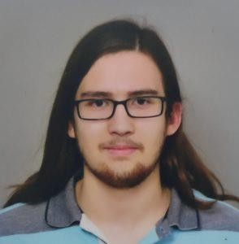
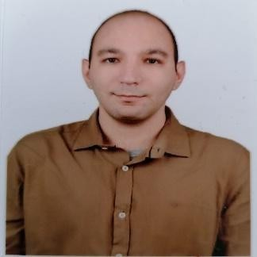
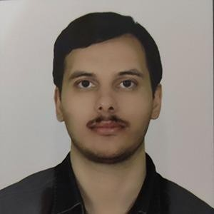
Department Academician Information
Prof. Dr. Hüseyin DEMİR | Assoc. Dr. Muammer TÜRKOĞLU Head of Dept. | Assoc. Dr. Zafer CÖMERT | Assoc. Dr. Abdulkadir KARACI | Assoc.Dr. Selçuk ÇAKMAK | Assist. Dr. Emel SOYLU | Assist. Dr. Nurettin ŞENYER
Assist. Dr. Özgür TONKAL | Researh Assist. Ferhat ARAT | Research Assist. Ömer DURMUŞ | Research Assist. İlker GÜR | Research Assist. Sarp ÇOBAN | Research Assist. Furkancan DEMİRCAN

Slide 6

Why Us?
Applied Lessons
Modern Classroom and Infrastructure Opportunity
Friendly Communication and Family Environment
Foreign Language Opportunity
Ability to Work with Industry Experts
Support for Academic Studies and Project-Based Thinking
Student Societies
Social Activities
DMP Opportunity
Erasmus Opportunity

Slide 7
Why Us?
There are a total of 358 students in the Software Engineering Department.
Figure 1 shows the number of students enrolled by year.
Figure 1. Number of students enrolled by year

Slide 8
Why Us?
Department Preference and Occupancy Rates
Year | Number of Quotas | Number of Students Enrolled | Occupancy Rate
2023 | 70 | 70 | %100
2022 | 60 | 60 | %100
2021 | 60 | 60 | %100
2020 | 60 | 60 | %100
2019 | 30 | 30 | %100

Slide 9
Our Possibilities
Undergraduate and Graduate Education Opportunities
Double Major Program
Student Exchange Programs
Professional Experience Programs
Student Societies Activities
Modern Classrooms and Laboratories
Studies in the Field of Artificial Intelligence
Project Based Education (Tübitak, Teydeb, Ardeb, Teknofest)

Slide 10

Technological and Physical Resource Analysis of the Department
There is a computer laboratory within the Software Engineering department. There are 30 desktop computers in this laboratory.
A physical laboratory environment has been established where students can work with their personal notebooks. There are two computer laboratories in common use at the Faculty of Engineering. There are 60 desktop computers in one of these laboratories and 40 desktop computers in the other.
Physics Basic Science Laboratory, Microprocessors and Microcontrollers Laboratory, and Logic Laboratory were established in our faculty. Up to 24 students can be trained at the same time in these laboratories.
A physical environment for 36 people has been established to support the projects that Software Engineering Department students will develop individually or as a team during their extracurricular time. Here, students are provided with electricity, internet resources and presentation resources.

Slide 11
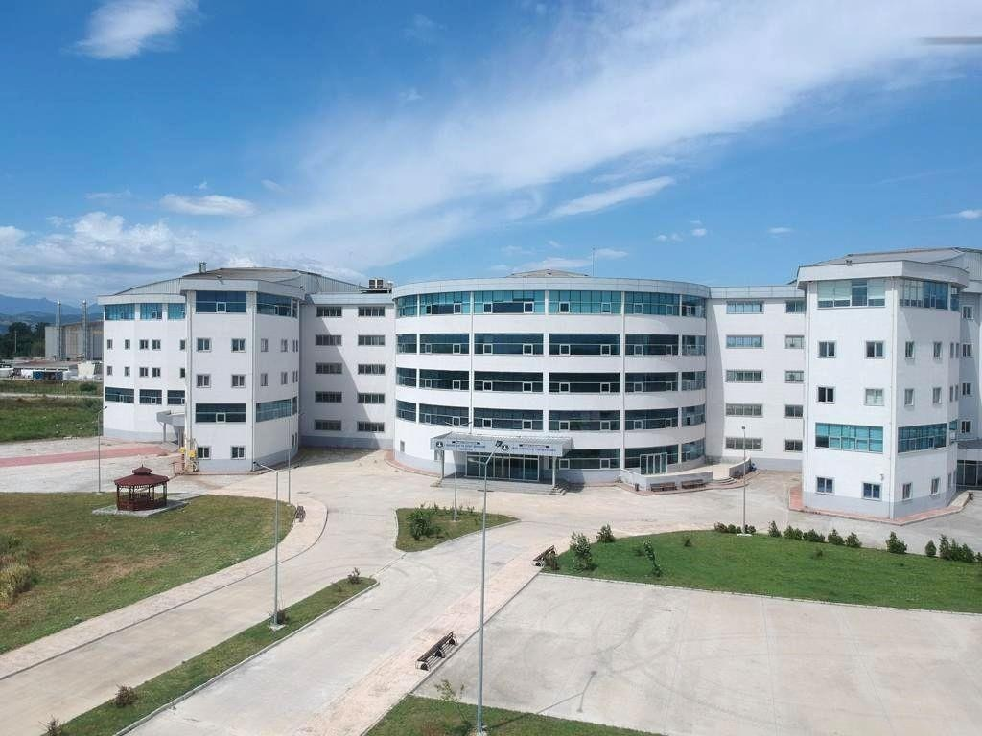
From Our Campus and Faculty

Slide 12




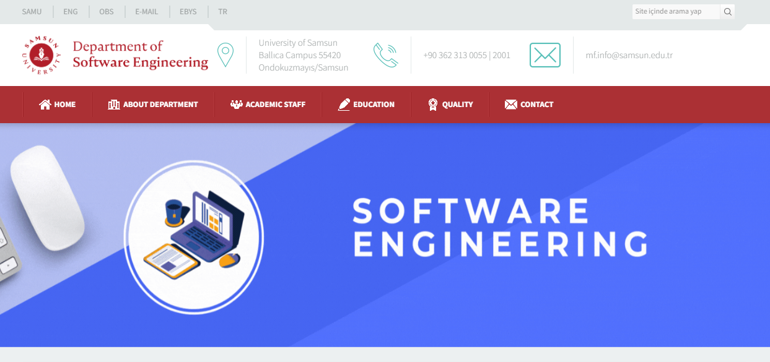
Contact Information
https://yazilimmuhendisligi-en.samsun.edu.tr/
https://www.instagram.com/samsun.mf/
https://yokatlas.yok.gov.tr/lisans.php?y=112771071

